Slide 1
Identifying amino acid predominant mutations in viruses by comparing matrices
Ankit Mukherjee
Guide: Dr. Shekhar C. Mande

Slide 2
BACKGROUND
Our idea is to compare viral protein specific substitution matrices with standard matrices like PAM (Point Accepted Mutation), revealing statistically significant mutations
Identifying these mutations enhances our understanding of the co-evolutionary dynamics between viruses and their hosts, particularly how viral mutations impact host immune responses and receptor interactions
The hypothesis to be addressed is that mutations are not random but are concentrated at specific positions. These might confer a selective advantage to the virus in the host-pathogen race, potentially increasing viral adaptiveness

Slide 3
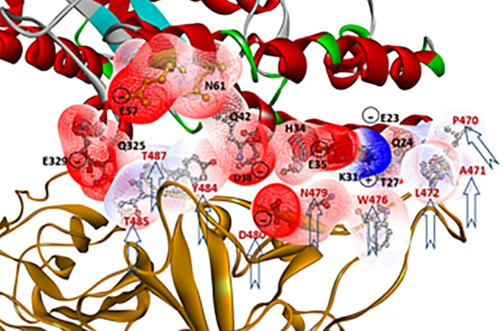
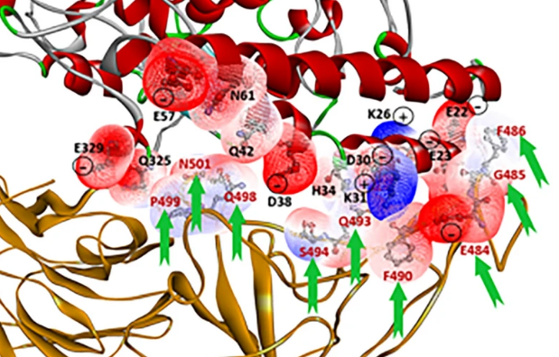
INTRODUCTION
Viruses have the ability to mutate spontaneously ultimately reflecting structural differences.
These lead to increased infectivity, enhanced transmissibility, and resistance to existing immune responses.
Adapted from
Yang, J., Zhang, P., Cheng, W.X. et al. Exposing structural variations in SARS-CoV-2 evolution. Sci Rep 11, 22042 (2021). https://doi.org/10.1038/s41598-021-01650-3

Slide 4
Rates of spontaneous vary amply among viruses. We mainly selected RNA viruses for study due to:
High Mutation Rate
Single Stranded Genome
High Availability of Sequences
Representative Virus of Different Families
Virus Family | Representative Virus | Genetic Material | Strand
Coronaviridae | Coronavirus (SARS-CoV-2) | RNA | Single Stranded
Flaviviridae | Hepatitis C Virus (HCV) | RNA | Single Stranded
Hepadnaviridae | Hepatitis B Virus (HBV) | DNA | Double Stranded
Orthomyxoviridae | Influenza A Virus | RNA | Single Stranded
Retroviridae | Human Immunodeficiency Virus (HIV) | RNA | Single Stranded

Slide 5
To classifying proteins having a significant effect of these spontaneous mutations in the evolution of the virus, the ratio of non-synonymous to synonymous substitutions (dN/dS) served as a useful measure.
Virus | Protein under Selection Pressure (ω > 1) | Protein presumably not under Selection Pressure (ω ≈ 1)
Coronavirus (SARS-CoV-2) | Spike Protein | M or Matrix/Membrane Protein
Hepatitis C Virus (HCV) | E2 Protein | Core Protein
Hepatitis B Virus (HBV) | L Protein | Core Protein
Influenza A Virus | HA and NA Proteins | M1 Protein
Human Immunodeficiency Virus (HIV) | Env Protein | Gag Protein

Slide 6
Point Accepted Mutation (PAM) matrix are constructed from standard proteins where each value are log – likelihood scores that reflect how likely one amino acid is substituted over the other.
Amino acid substitution matrices can help in studying which mutations are more likely to occur than expected by chance.
Identifying these mutations enhances our understanding of the mechanisms by which viruses adapt and evade immune responses. Such knowledge is critical for anticipating viral behavior and potential outbreaks.

Slide 7
METHODOLOGY
Sequence Downloading and Filtering
Sequences of virus were downloaded from NCBI virus and GISAID database.
Using CD-HIT to keep only unique sequences by removing sequences which are 100% similar.
Filtering sequences by length (decided on the basis of the length of the protein).

Slide 8
Virus | Protein | Sequence Length (aa)
 |  | Lower Limit | Upper Limit
Coronavirus (SARS-CoV-2) | Spike Protein | 1200 | 1300
 | M or Matrix/Membrane Protein | 222 | 222
Hepatitis C Virus (HCV) | E2 Protein | 300 | 400
 | Core Protein | 170 | 200
Hepatitis B Virus (HBV) | L Protein | 300 | 400
 | Core Protein | 170 | 215
Influenza A Virus | HA Protein | 550 | 570
 | NA Protein | 460 | 480
 | M1 Protein | 252 | 252
Human Immunodeficiency Virus (HV) | Env Protein | 800 | 900
 | Gag Protein | 450 | 550

Slide 9
Removing sequences which contain ambiguous characters.
Performing MSA using MAFFT. Sequences containing large gaps were removed and MSA was performed again.

Slide 10
Virus | Protein | Number of Sequences
 |  | Before Filtering | After Filtering
Coronavirus (SARS-CoV-2) | Spike Protein | 14628247 | 22874
 | M or Matrix/Membrane Protein | 3822066 | 3723
Hepatitis C Virus (HCV) | E2 Protein | 2635 | 1871
 | Core Protein | 5644 | 1366
Hepatitis B Virus (HBV) | L Protein | 829 | 264
 | Core Protein | 21015 | 4283
Influenza A Virus | HA Protein | 1141 | 474
 | NA Protein | 135125 | 40150
 | M1 Protein | 119100 | 5255
Human Immunodeficiency Virus (HIV) | Env Protein | 328676 | 71783
 | Gag Protein | 204751 | 23351

Slide 11
Algorithm Of PAM Amino Acid Substitution Matrix
Following the same algorithm as PAM, matrices are formed from processed sequences of the proteins that are under selection pressure and control proteins from the same virus.
Protein Sequence Similarity
Protein Sequence Similarity was assessed using “Align two or more sequences” option in blastp.

Slide 12
Calculating dN/dS ratio
Proteins chosen for study were based on the ratio of non-synonymous to synonymous mutations based on literature survey.
MEGA software used to analyze:
Proteins chosen for positive selection pressure had ω > 1
Proteins chosen for control had ω ≈ 1

Slide 13
Identifying Significant Mutations
Chi-squared test was carried out to assess whether the matrices compared were significant or not. Matrix compared:
&
Calculating difference matrix and Standard Deviation (SD) to assess which mutations show values higher than the value in difference matrix:
Protein under Selection Pressure and Dayhoff PAM250
Control Protein and Dayhoff PAM250

Slide 14
Calculating average differences between protein under selection pressure and Dayhoff PAM250
Calculating SD
Calculating Difference Matrix (Protein under Selection Pressure and Dayhoff PAM250)
Identifying values more than SD in the difference matrix

Slide 15

Calculating Entropy at every sequence position
Shannon Entropy in sequence analysis refers to the measure of the variation of characters (column) in multiple sequences.
The more conserved a column, the smaller is its entropy.
Filtering variable positions i.e. positions with high entropy values with an assumed cutoff
$$H=−\sum{p\left(x\right)\log{p\left(x\right)}}$$

Slide 16
Calculating Codon Usage
Codon usage bias can preferentially use one synonymous codon among other synonymous codons of an amino acid
Codon Usage Server used for analysis
Mantel Test
Measures the correlation between two matrices
Implemented using vegan package in R

Slide 17
RESULTS
Protein Sequence Similarity
Using blastp it was verified that all sequences considered for analysis were at least 85 % identical.
This helped in applying PAM algorithm to the filtered sequences for deriving the matrices.

Slide 18
Protein under Selection Pressure and Control Protein
Proteins under selection pressure have ω > 1 and control proteins have ω ≈ 1
Variability in protein sequence
Position with high entropy values are more prone to changes in the DNA sequence
This ultimately gets reflected in the protein structure and thus the function of the protein.

Slide 19
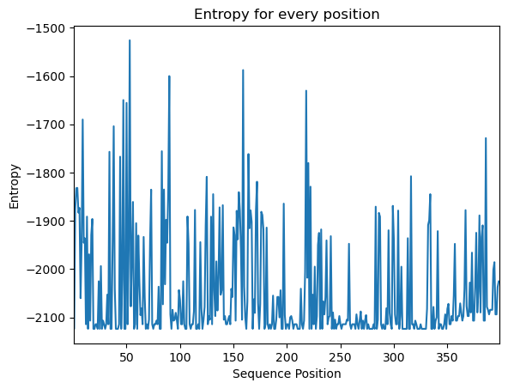
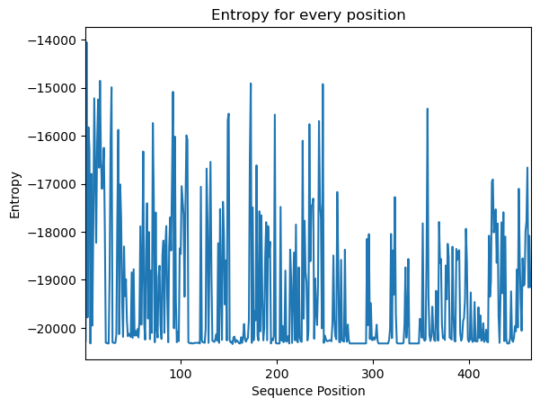
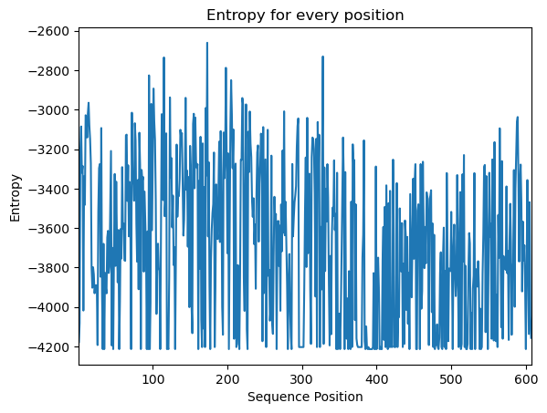
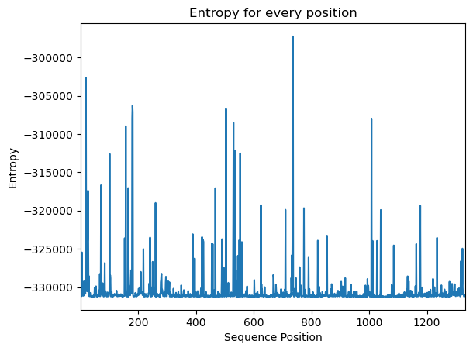
Figure 1: Entropy for every position of (Top left) HBV protein preS, (Top right) HCV protein E2, (Bottom left) Influenza HA, (Bottom right) SARS-CoV-2 Spike Protein

Slide 20
The most variable positions were mapped onto the respective proteins using Pymol software.
These proteins were curated using blastp of virus protein sequences against PDB database with the best alignment scores and E value.
Virus | Protein | PDB ID
Coronavirus (SARS-CoV-2) | Spike Protein | 7KRQ
Hepatitis B Virus (HBV) | L Protein | 7TUK
IInfluenza A Virus | HA Protein | 6IDD
 | NA Protein | 6IXK

Slide 21
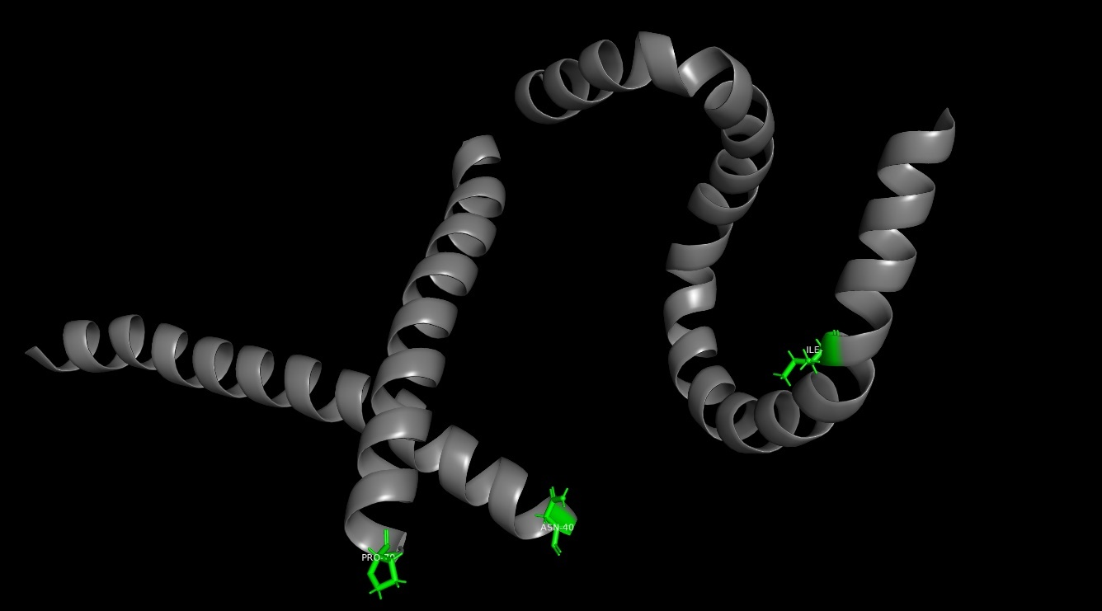
The mutations in HBV protein are mainly located in α-helix region which are secondary structures of the protein that might play an essential role in interactions with the host receptor.
Figure 2: Mutations labelled and highlighted as green with stick representation for HBV protein preS

Slide 22
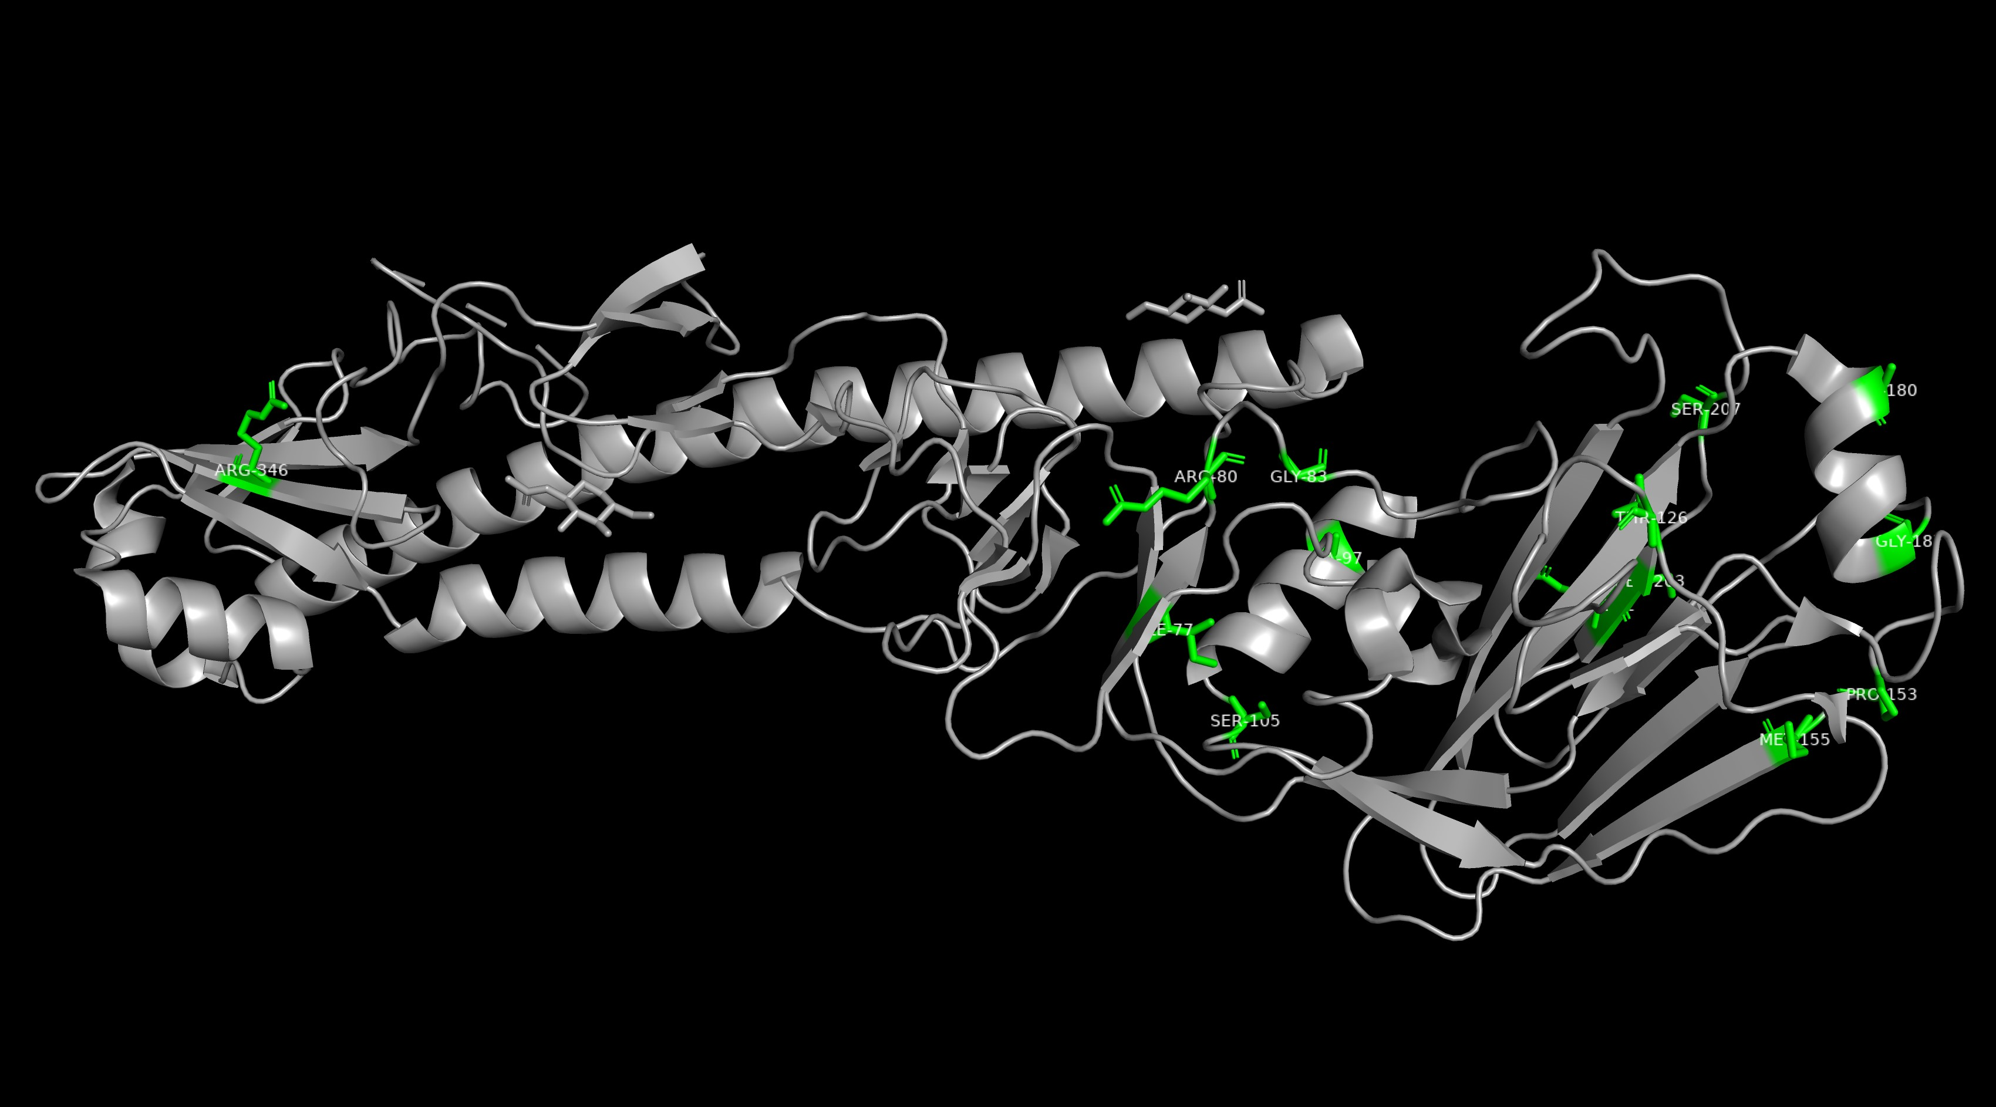
In Hemagglutinin, the mutations are dispersed among the secondary structures α-helix, β-sheets as well as the coiled coil regions.
Figure 2: Mutations labelled and highlighted as green with stick representation for Influenza protein Hemagglutinin

Slide 23
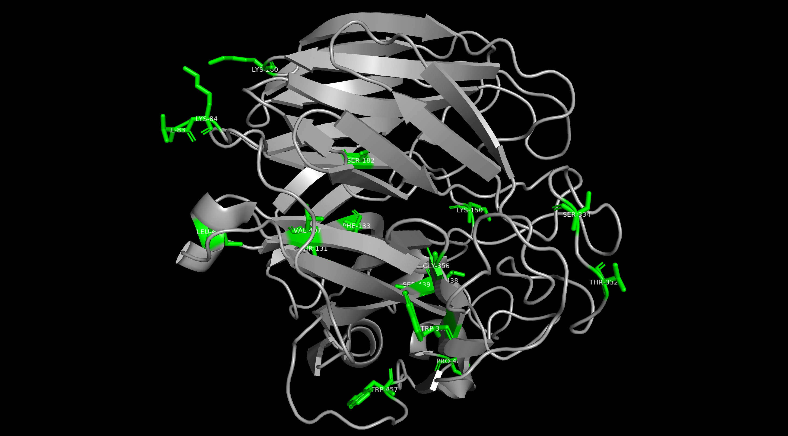
Most of the mutations in neuraminidase are constricted in the loop regions which are variable and are prone to frequent mutations.
Figure 2: Mutations labelled and highlighted as green with stick representation for Influenza protein Neuraminidase

Slide 24
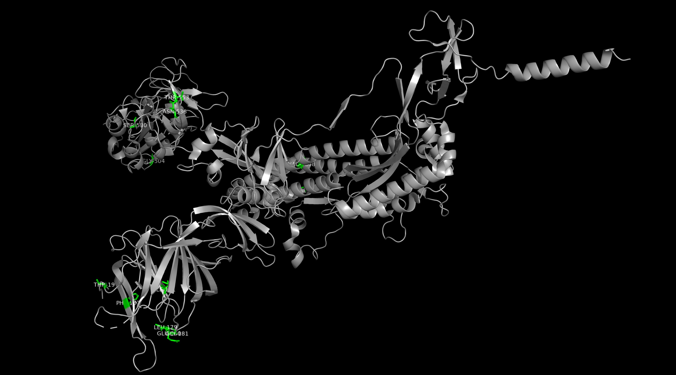
Mutations in spike protein are mostly in the Receptor Binding Domain (RBD) and N-terminal domain (NTD) which plays an important role in virus infection.
Figure 2: Mutations labelled and highlighted as green with stick representation for SARS-CoV-2 Spike protein

Slide 25
Analysis of Significant Mutations
Comparison of matrix derived from protein under selection pressure and Dayhoff PAM250
Cysteine to Phenylalanine,
Phenylalanine to Tryptophan,
Alanine (Glutamic Acid, Isoleucine, Methionine, Glycine) to Tryptophan

Slide 26
HBV
Cysteine has two codons TGT and TGC. TGC is the preferential codon.
Phenylalanine has two codons TTC and TTT. TTC is the preferential codon.
Methionine has one codon ATG mutating to Tryptophan codon TGG
TGC
TTC
ATG
TGC

Slide 27
Influenza A
Alanine have four codons GCG, GCA, GCT and GCC. GCA and GCT are the preferential codons. These mutate to Tryptophan codon TGG
This involves change in all three positions
This is a change of an amino acid bearing an aliphatic side chain to an amino acid having aromatic side chain
GCA
GCT
TGG

Slide 28
Comparison of matrix derived from control protein and Dayhoff PAM250
Cysteine to Tryptophan (Leucine, Methionine)
Cysteine has two codons TGT and TGC. TGT is preferential in HBV.
TGT
TGG

Slide 29
Cysteine mutating into Leucine involves change in 2nd and 3rd base position
But, side chains are both aliphatic in nature. Therefore, the mutation might not be significant.
Cysteine mutating into Methionine won’t affect the structure of the protein.
Both have aliphatic side chains and a sulfhydryl group due to which no interactions would be affected.

Slide 30
Mantel Test
Expected Result: Matrices derived from proteins under selection pressure should have lower correlation with PAM250 compared to matrices derived from control proteins
The outcome was not according to the expected result

Slide 31
CONCLUSION
Significance of Specific Mutations
The study identifies significant mutations in viral proteins that confer selective advantages to viruses.
These mutations are critical for understanding viral adaptation to new hosts and environments.

Slide 32
Impact on Viral Evolution and Host Immune Response
Monitoring these position – specific mutations helps in understanding the co-evolution of viruses and their hosts.
The method developed in this study is essential for the rapid identification of significant mutations, which can accelerate the process of vaccine development
Application in Vaccine Development

Slide 33
FUTURE PROSPECT
Extend the methodology to analyze mutations in a wider range of viruses, including those with different genomic structures and replication mechanisms.
Further refine the substitution matrices by incorporating more extensive and diverse sequence data.
Combine the findings with structural biology techniques to understand how identified mutations affect protein structure and function.

Slide 34
Utilize the identified mutations as targets for vaccine and antiviral drug development.
Investigate the impact of identified mutations on host-virus interactions in more detail.
Conduct evolutionary studies to trace the origins and spread of significant mutations across different geographical regions and host species.
Integrate the mutation data with other omics data (e.g., transcriptomics, proteomics) and apply machine learning techniques to uncover patterns and predict future mutation trends.

Slide 35
ACKNOWLEDGEMENT
I extend my heartfelt appreciation to Dr. Shekhar Mande for generously dedicating his valuable time to contribute to my project.
Additionally, I am immensely grateful to Dr. Payel Ghosh for her unwavering support and guidance throughout the entire process.
Their expertise and assistance have been invaluable, and I am truly thankful to Bithika Chatterjee, my family and friends (Pradnya) for the success of my project.

Slide 36
REFERENCES
Articles
Alqahtani, A.; Almutairy, M. Evaluating the Performance of Multiple Sequence Alignment Programs with Application to Genotyping SARS-CoV-2 in the Saudi Population. Computation 2023, 11, 212. https://doi.org/10.3390/computation11110212
Cuypers L, Li G, Libin P, Piampongsant S, Vandamme AM, Theys K. Genetic Diversity and Selective Pressure in Hepatitis C Virus Genotypes 1-6: Significance for Direct-Acting Antiviral Treatment and Drug Resistance. Viruses. 2015 Sep 16;7(9):5018-39. doi: 10.3390/v7092857. PMID: 26389941; PMCID: PMC4584301.
Dayhoff MO, Schwartz RM, Orcutt BC (1978). "A model of Evolutionary Change in Proteins". Atlas of protein sequence and structure (volume 5, supplement 3 ed.). Washington, DC.: National Biomedical Research Foundation. pp. 345–358. ISBN 978-0-912466-07-1
Emam M, Oweda M, Antunes A, El-Hadidi M. Positive selection as a key player for SARS-CoV-2 pathogenicity: Insights into ORF1ab, S and E genes. Virus Res. 2021 Sep;302:198472. doi: 10.1016/j.virusres.2021.198472. Epub 2021 Jun 10. PMID: 34118359; PMCID: PMC8190378.
Fu L, Niu B, Zhu Z, Wu S, Li W. CD-HIT: accelerated for clustering the nextgeneration sequencing data. Bioinformatics. 2012 Dec 1;28(23):3150-2. doi: 10.1093/bioinformatics/bts565. Epub 2012 Oct 11. PMID: 23060610; PMCID: PMC3516142.
Jeffares DC, Tomiczek B, Sojo V, dos Reis M. A beginners guide to estimating the non-synonymous to synonymous rate ratio of all protein-coding genes in a genome. Methods Mol Biol. 2015;1201:65-90. doi: 10.1007/978-1-4939-1438-8_4. PMID: 25388108.
Li, S., Wang, Z., Li, Y. et al. Adaptive evolution of proteins in hepatitis B virus during divergence of genotypes. Sci Rep 7, 1990 (2017). https://doi.org/10.1038/s41598-017-02012-8

Slide 37
Articles
Louie RHY, Kaczorowski KJ, Barton JP, Chakraborty AK, McKay MR. Fitness landscape of the human immunodeficiency virus envelope protein that is targeted by antibodies. Proc Natl Acad Sci U S A. 2018 Jan 23;115(4):E564-E573. doi: 0.1073/pnas.1717765115. Epub 2018 Jan 8. PMID: 29311326; PMCID: PMC5789945.
Parvathy ST, Udayasuriyan V, Bhadana V. Codon usage bias. Mol Biol Rep. 2022 Jan;49(1):539-565. doi: 10.1007/s11033-021-06749-4. Epub 2021 Nov 25. PMID: 34822069; PMCID: PMC8613526.
Sanjuán R, Domingo-Calap P. Mechanisms of viral mutation. Cell Mol Life Sci. 2016 Dec;73(23):4433-4448. doi: 10.1007/s00018-016-2299-6. Epub 2016 Jul 8. PMID: 27392606; PMCID: PMC5075021.
Tusche C, Steinbrück L, McHardy AC. Detecting patches of protein sites of influenza A viruses under positive selection. Mol Biol Evol. 2012 Aug;29(8):2063-71. doi: 10.1093/molbev/mss095. Epub 2012 Mar 16. PMID: 22427709; PMCID: PMC3408068.
URLs
https://www.ncbi.nlm.nih.gov/labs/virus/
https://gisaid.org/
https://blast.ncbi.nlm.nih.gov/Blast.cgi
https://www.bioinformatics.org/sms2/codon_usage.html

Slide 38
THANK YOU

